Slide 1


Predicting Purchase Behavior in Social Network Ads
International Summer School
Course: Data Mining for Business Intelligence
~ Amir

Slide 2
Outline
Introduction
Literature Review
Data Collection
Exploratory Data Analysis
Data Preprocessing
System Architecture
Result Evaluation
Conclusion
Reference

Slide 3
Introduction
Social network ads are advertisements that are displayed on social media platforms, such as Facebook, Instagram, Twitter, and LinkedIn.
These ads can be targeted to specific audiences based on factors such as age, gender, location, interests, and behaviors.
Businesses and organizations use social network ads to promote their products or services to potential customers who are active on these platforms.
The objective of this analysis is to predict whether a person will buy a product displayed on a social network ad or not, given their age, gender, and salary, and to compare the accuracy of different classification algorithms.

Slide 4
Literature Review
  "An overview of digital media and advertising: An Overview" Dickey, I. J., & Lewis, W. F.: This paper [1] provides a comprehensive overview of social media advertising and its various forms, including display ads, sponsored posts, and influencer marketing.
  "Targeting Consumers on Social Media: An Analysis of Facebook Advertising" by Ferreira, F., & Barbosa, B: This paper [2] analyzes the targeting capabilities of Facebook advertising and the ways in which they can be used to reach specific audiences.

Slide 5
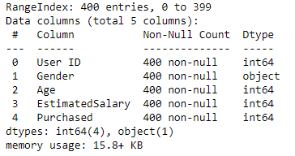
Data Collection
The data is about Kaggle [3].
The dataset includes customer id, gender, age, salary, and whether he/she purchased anything or not.
Data Info

Slide 6
Exploratory Data Analysis
How is gender distributed?
How is age distributed?
Is there any correlation between salary and age?
Statistics for purchase feature

Slide 7
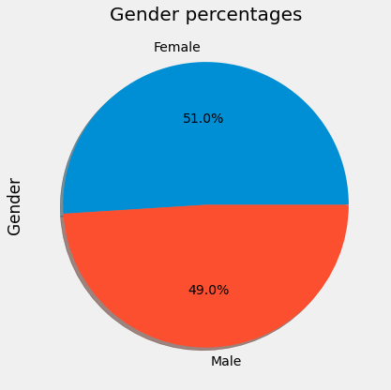
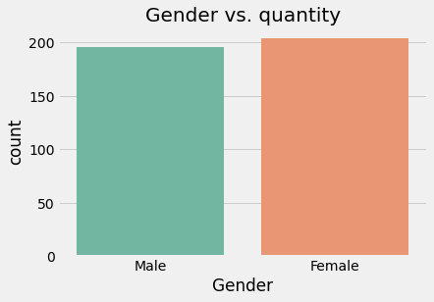
Gender Distribution
It seems that both gender are equally distributed

Slide 8
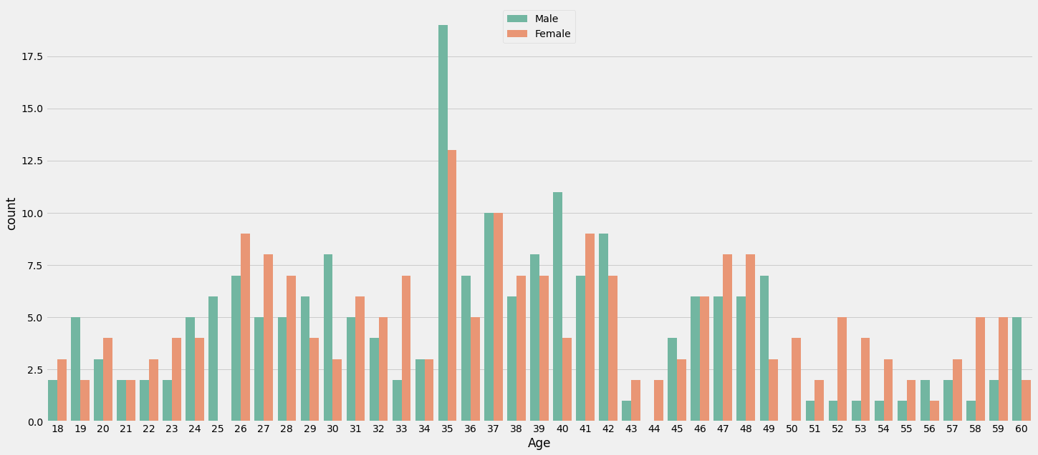
Age Distribution
There seems to be equal analyzed people per gender per age, seeing only more men of 35 years.

Slide 9
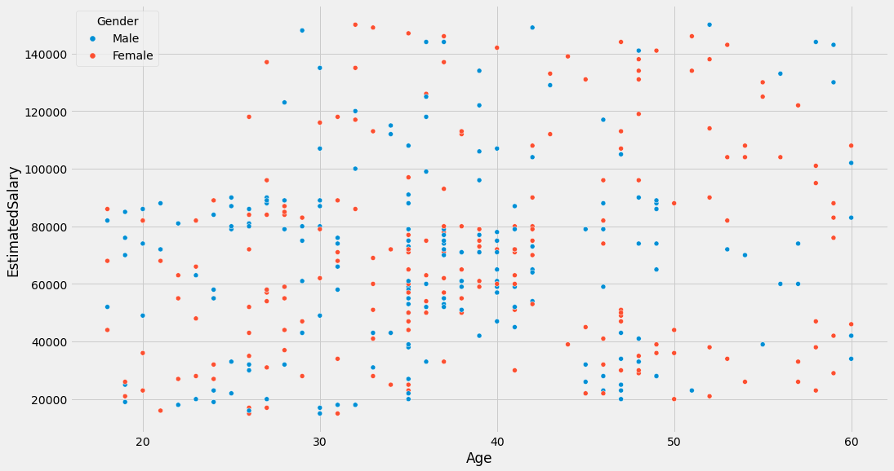
Is there any correlation between salary and age?
There is no correlation between the estimated salary of a male or female with their age

Slide 10
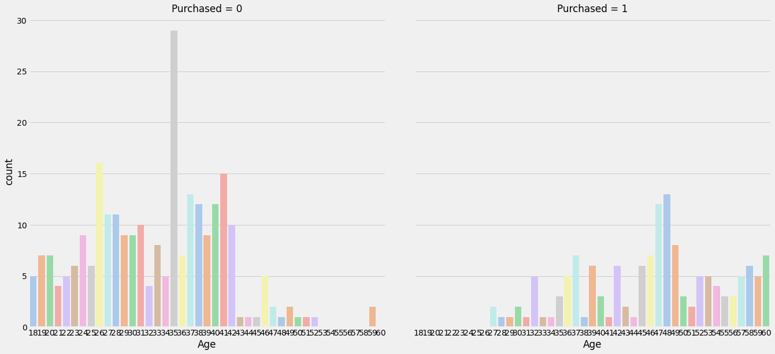
Statistics for the purchased column
The product seems to be intended for people within the range of 50 - 60 years

Slide 11
Data Preprocessing
Handle Missing Values
  Mode for Gender Feature
  Mean for Age Feature
Feature Scaling
  Standard Scaler
Label Encoder
  Convert Gender Feature into Numerical Value
Split the Data
  80% for Train
  20% for Test

Slide 12
System Architecture
Naïve Bayes
Decision Tree
K-Nearest Neighbors
Support Vector Machine
Multilayer Perceptron's

Slide 13
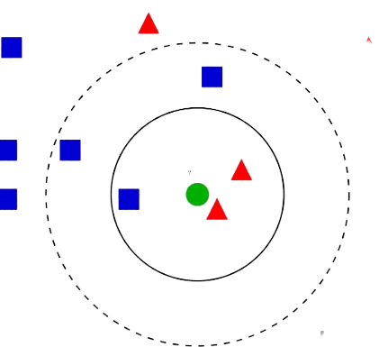
K-Nearest Neighbors
The algorithm finds the k-number of closest data points in the training set to a given test point, and uses the majority class or average value of those points to make a prediction.
The distance metric used to determine the "closeness" of data points can vary, such as Euclidean distance or Manhattan distance.

Slide 14
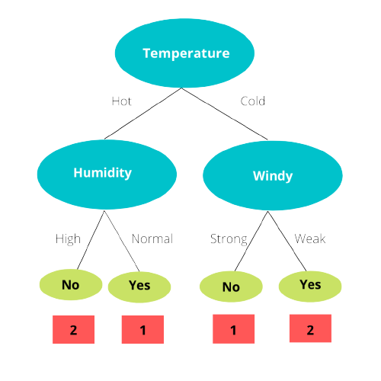
Decision Tree
The algorithm creates a tree-like model of decisions and their possible consequences.
Each internal node in the tree represents a "test" on an attribute, each branch represents the outcome of the test, and each leaf node represents a class label.

Slide 15
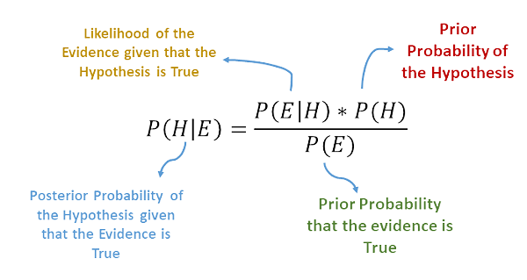
Naïve Bayes
It is based on Bayes' theorem, which describes the probability of an event occurring given the probability of certain related events.
The "naive" part of the name comes from the assumption that the input features are independent of each other, given the output class.

Slide 16
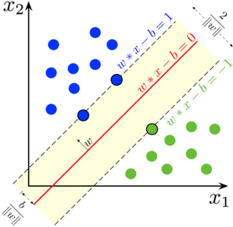
Support Vector Machine
A machine learning algorithm that identifies the optimal line or surface to separate data points of different classes by maximizing the margin.
It's effective for classification tasks and works well even in cases of complex data by focusing on the most influential data points near the decision boundary.

Slide 17
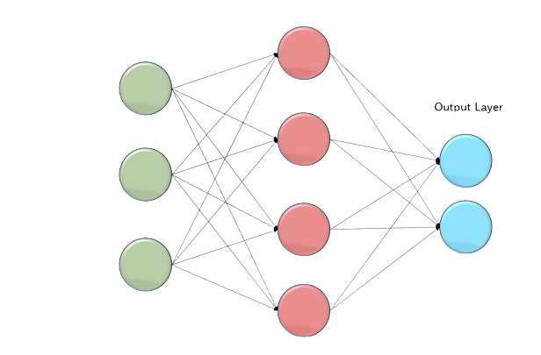
Multilayer Perceptron's
Neural networks with multiple layers of nodes, enabling them to learn complex patterns and perform tasks like classification and regression.
MLPs can capture intricate data relationships through hidden layers and activation functions, making them versatile for a wide range of machine learning problems

Slide 18
Multilayer Perceptron's
Neural networks with multiple layers of nodes, enabling them to learn complex patterns and perform tasks like classification and regression.
MLPs can capture intricate data relationships through hidden layers and activation functions, making them versatile for a wide range of machine learning problems

Slide 19
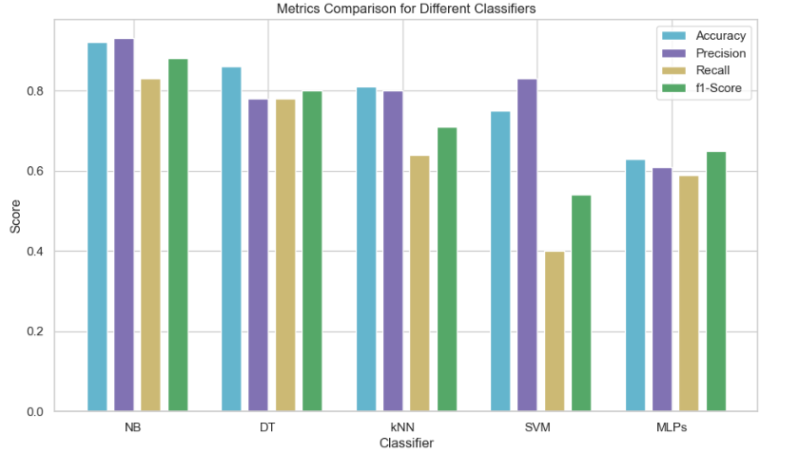
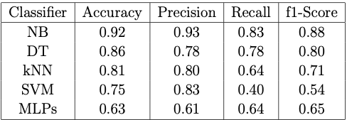
Result Evaluation
Results Matrix
Results Visualisation

Slide 20
Conclusion
The task of predicting purchase behavior in a social network ad campaign was evaluated using multiple classifiers. The Naive Bayes classifier outperformed others with the highest accuracy and balanced performance in precision, recall, and F1-Score. The study sheds light on effective model selection for optimizing ad campaign outcomes

Slide 21
Reference
  [1] Dickey, I. J., & Lewis, W. F. (2012). An overview of digital media and advertising. E-marketing: Concepts, methodologies, tools, and applications, 31-61.
  [2] Ferreira, F., & Barbosa, B. (2017). Consumers' attitude toward Facebook advertising. International Journal of Electronic Marketing and Retailing, 8(1), 45-57.
  [3] https://www.kaggle.com/datasets/rakeshrau/social-network-ads

Slide 22
Thank You For Your Attention
Any Question?
Notes:
I hope I will cross 100

